Slide 1
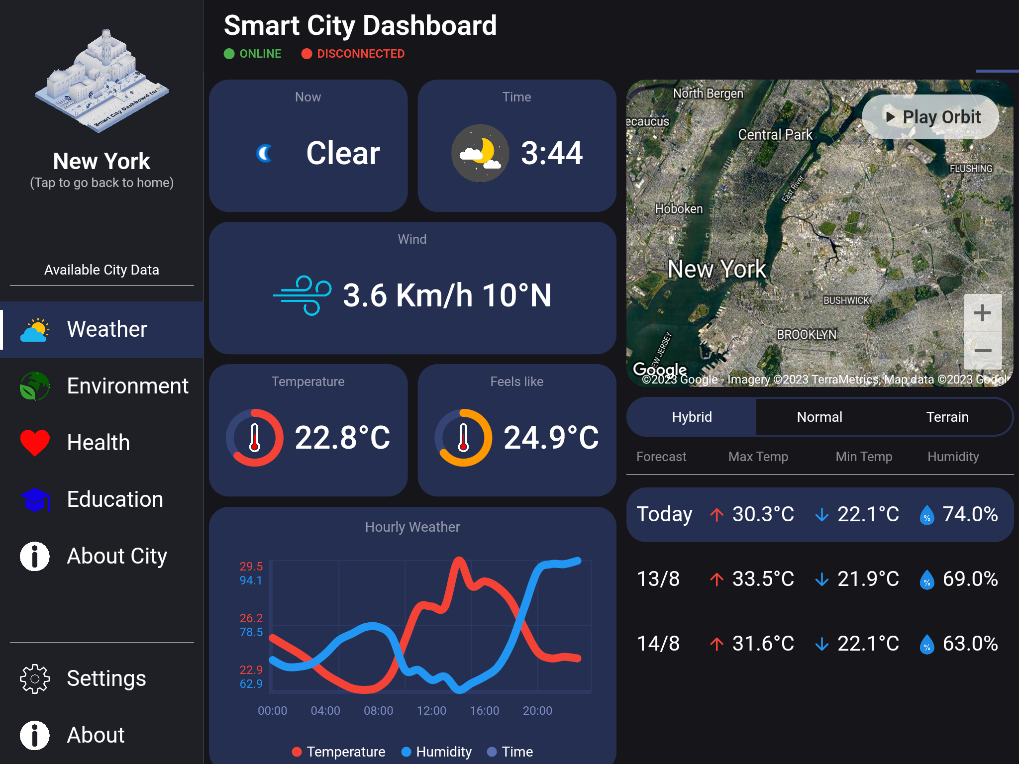





PROJECT COMPETITION 2026
India Smart City
Dashboard
A Unified Platform for Real-Time Urban Monitoring
Cities
Avg AQI
Water
Speed
20
115
18.5K
28
Smart Cities
Air Quality Index
Liters/Day
km/h Avg
Real-Time Urban Monitoring System
Version 1.0 | March 2026
India Smart Cities Mission | Ministry of Housing & Urban Affairs

Slide 2




Problem & Solution
The Problem
Our Solution
Indian cities are growing rapidly
Unified real-time monitoring platform
Urban management is fragmented
Consolidates Traffic, AQI, Water Usage, Alerts
Traffic, air quality, and water distribution managed in silos
One interactive interface for all domains
No unified platform for real-time decision-making
Real-time decision-making capabilities
Single Dashboard. Complete Visibility.
Fragmented Urban Data

Slide 3




Key Features
Unified Monitoring
Live Multi-Domain Tracking
Real-time monitoring for all 20 Smart Cities Mission cities from a single interface
Track Traffic Congestion, AQI, and Water Consumption simultaneously with live sensor data
Interactive Map Visualization
Actionable Alert System
Leaflet.js maps with colour-coded city markers, heatmap overlays, and clickable city popups
Surface traffic incidents, water leaks, and AQI breaches to operators in real time

Slide 4









Dashboard in Action
Real-Time KPI Cards
Live Analytics
Traffic: 2,808/hr (Medium)
Traffic flow trends
AQI: 78 (Moderate)
AQI 24h monitoring
Water: 18,497L (67% full)
Water consumption patterns
Image failed to load:
https://z-cdn-media.chatglm.cn/files/fb8f91b9-973d...
Active Alerts
Live Updates
12
8
4
Auto-refresh every 2-3 seconds
Total
Resolved
Active
Priority alerts for accidents, leaks & breaches
WebSocket push notifications

Slide 5




















Technical Architecture
Layer 4: Users
City Administrators
National Monitors
Field Officers
Emergency Responders
End Consumers & Operators
Layer 3: React Frontend
Single Page Application (SPA) with Live Updates
Interactive Leaflet Maps
SVG Charts (Bar/Pie)
Live KPI Cards
Alert Panel
Layer 2: Node.js Backend
Data Aggregation
Alert Processing
REST API
WebSocket Push
Event-Driven Server with WebSocket Support
Layer 1: Data Sources
IoT Sensors (20 Cities)
CPCB AQI APIs
NRSC Satellite Data
IoT Sensors & External APIs

Slide 6







Impact & Benefits
What the System Achieves
Key Advantages
Instant Data Access
Unified real-time interface for all urban domains
Decision-makers get national urban health data within 3 seconds of loading
Zero-dependency prototype — single HTML5 file, immediate deployment
Scalable design — migration path to React + Node.js production system
Prioritized Alerts
Field teams receive prioritized alerts for accidents, water leaks, and AQI emergencies
Interactive Leaflet.js maps with AQI heatmaps and clickable city popups
Covers all 20 India Smart Cities Mission cities with city-level data
Visualized Insights
Urban planners identify pollution hotspots, congestion patterns, and water anomalies via trend charts
20
4
3s
Cities
Domains
Load Time
API Integration Ready
Foundation for integration with CPCB, NRSC, and Smart City IC3 Command Centres

Slide 7



Future Roadmap
Current Limitations
Future Roadmap
Simulated data — not connected to live CPCB/NRSC APIs
2
Production System
3
Predictive Analytics
React + Node.js with live CPCB/NRSC API integration
ML-based AQI forecasting & traffic prediction models
No backend authentication or data persistence
4
Mobile App
5
Command Centre Integration
React Native app for field officers & emergency responders
NUIS and Smart City IC3 Command Centres connectivity
Street-level traffic map covers Bengaluru only
6
Security & Compliance
No mobile app for field officers
DPDPA 2023 compliance and end-to-end TLS 1.3 encryption
Smarter Cities. Safer Citizens. Sustainable Future.

